Slide 1

CSS
Lesson 11

Slide 2
CSS Selectors
Pattern | Meaning | Described in section
* | Matches any element. | Universal selector
E | Matches any E element (i.e., an element of type E). | Type selectors
E F | Matches any F element that is a descendant of an E element. | Descendant selectors
E > F | Matches any F element that is a child of an element E. | Child selectors
E + F | Matches any F element immediately preceded by a sibling element E. | Adjacent selectors
DIV.warning | Language specific. (In HTML, the same as DIV[class~="warning"].) | Class selectors
E#myid | Matches any E element with ID equal to "myid". | ID selectors

Slide 3
CSS Selectors
E[foo] | Matches any E element with the "foo" attribute set (whatever the value). | Attribute selectors
E[foo="warning"] | Matches any E element whose "foo" attribute value is exactly equal to "warning". | Attribute selectors
E[foo~="warning"] | Matches any E element whose "foo" attribute value is a list of space-separated values, one of which is exactly equal to "warning". | Attribute selectors

Slide 4
CSS Selectors
Grouping
When several selectors share the same declarations, they may be grouped into a comma-separated list.
h1 { font-family: sans-serif }
h2 { font-family: sans-serif }
h3 { font-family: sans-serif }
h1, h2, h3 { font-family: sans-serif }

Slide 5


CSS Selectors
Universal Selector
The universal selector, written "*", matches the name of any element type.

Slide 6

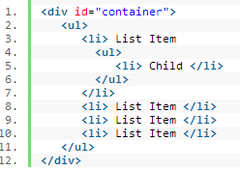
CSS Selectors
Child Selectors
The difference between the standard X Y and X > Y is that the latter will only select direct children.

Slide 7

CSS Selectors
Adjacent sibling Selectors
This is referred to as an adjacent selector. It will select only the element that is immediately preceded by the former element. In this case, only the first paragraph after each ul will have red text.

Slide 8
CSS Selectors
Attribute Selectors
[att]
Match when the element sets the “att" attribute
[att=val]
Match when the element's "att" attribute value is exactly "val".
Represents an element with the att attribute whose value is a white space-separated list of words, one of which is exactly "val“.
[att~=val]

Slide 9
CSS Selectors
Attribute Selectors
[att*=val]
The star designates that the proceeding value must appear somewhere in the attribute’s value.
Other selectors....
[att|=val]
[att^=val]
[att$=val]

Slide 10




CSS Selectors
Attribute Selectors

Slide 11
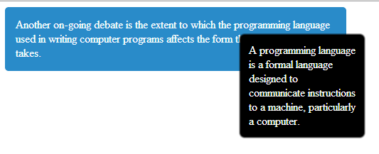
Task1:

Slide 12
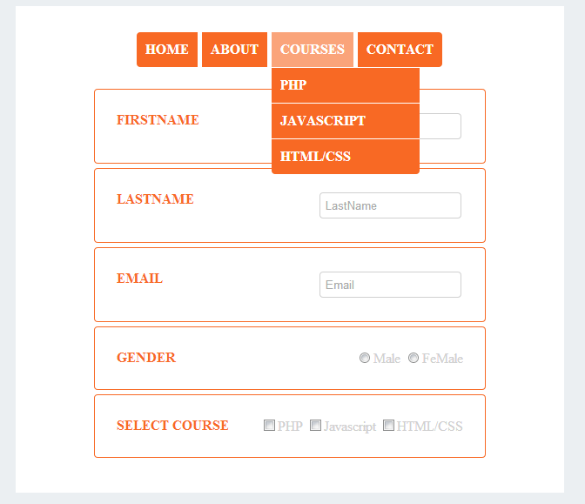
Task2:

